Slide 1
Mathematic for Computer Science - III CS203B
Lecture 7:
Well known random variables
Linearity of expectation (2 problems).
Conditional Expectation

Slide 2
Summary of last class

Slide 3
Random variables

Slide 4

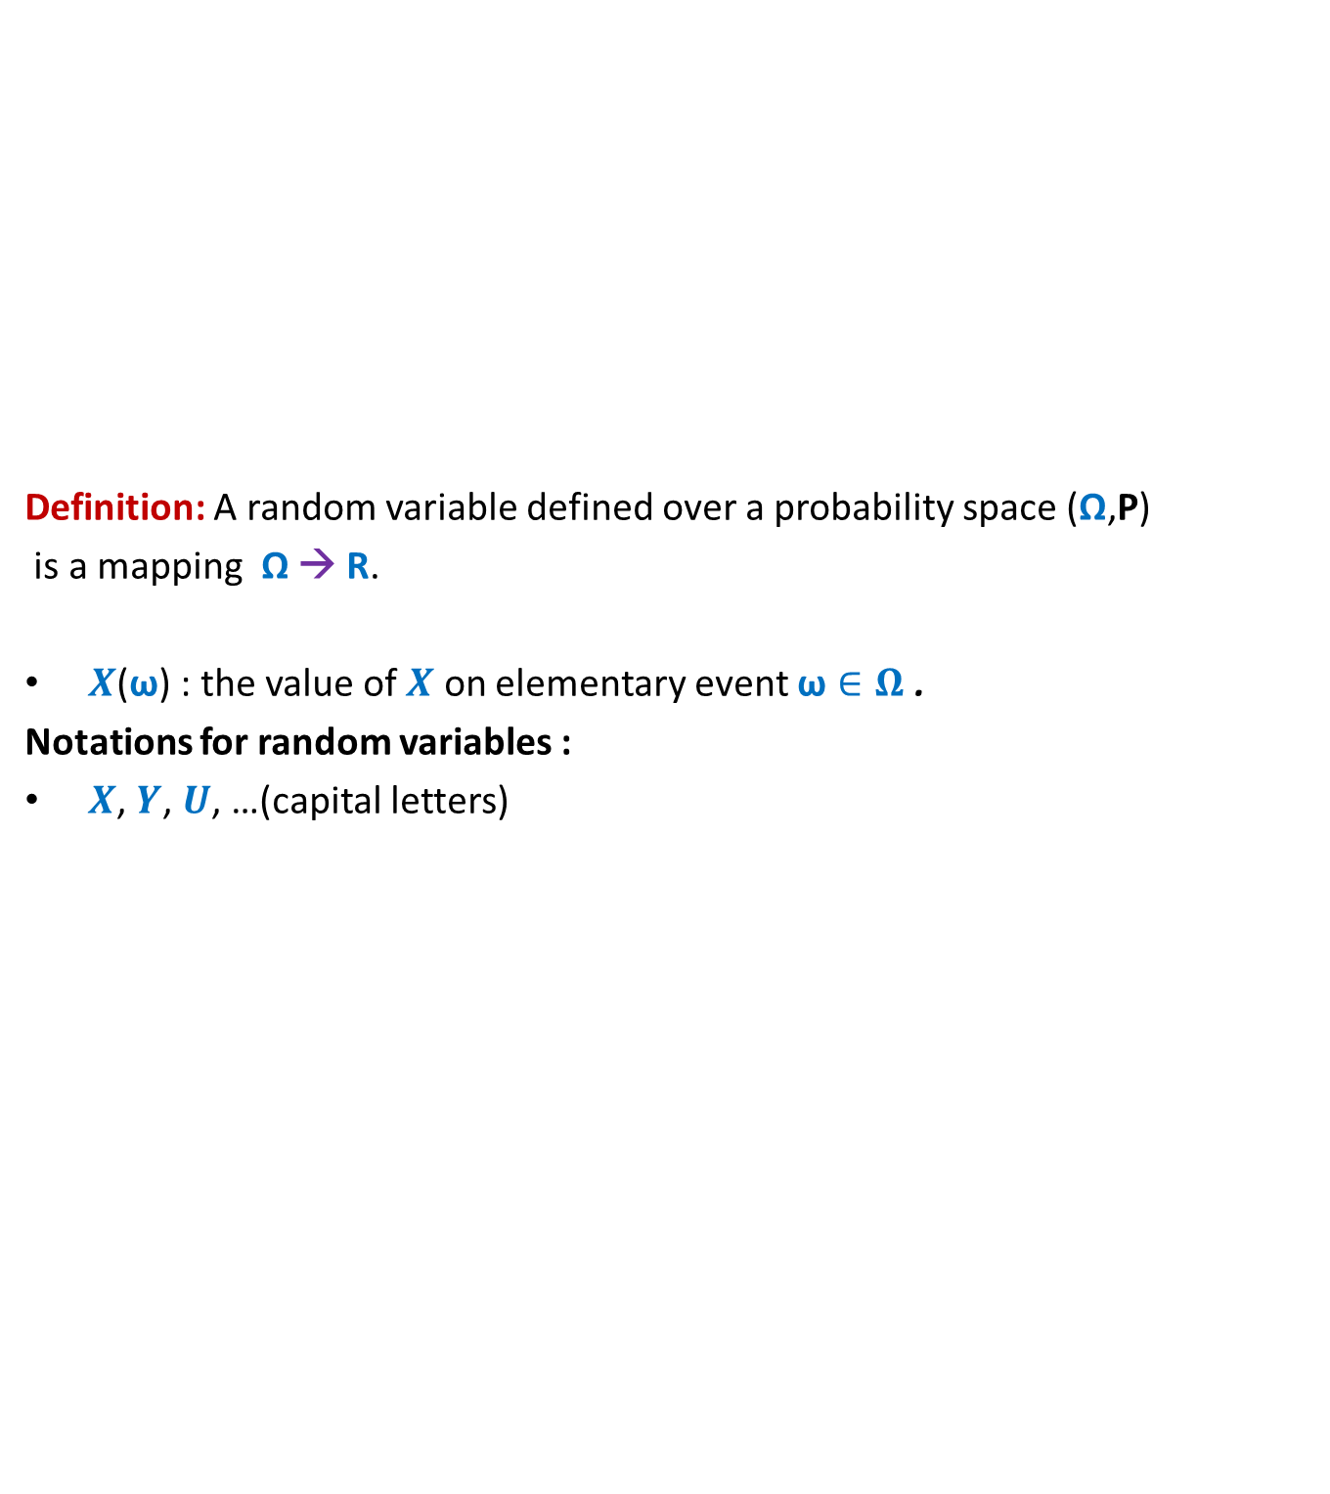
Random variable
Definition: A random variable defined over a probability space (Ω,P)
is a mapping Ω → R.
$X$($\text{ω}$) : the value of $X$ on elementary event $\text{ω}∈Ω$ .
Notations for random variables :
$X$, $Y$, $U$, …(capital letters)
$$X$$
Set of real numbers
R
Ω

Slide 5


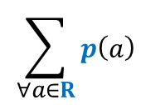

Probability mass function
For a random variable $X$ defined over a discrete probability space (Ω,P)
mass function $p$ is defined as follows.
Question: What is ?
Answer: $1`$
$$p\left(a\right)$$
$$= P(X=a)$$
$$\sum_{∀a∈R}{p\left(a\right) }$$

Slide 6
Some Well Known and Well STUDIED Random Variables

Slide 7
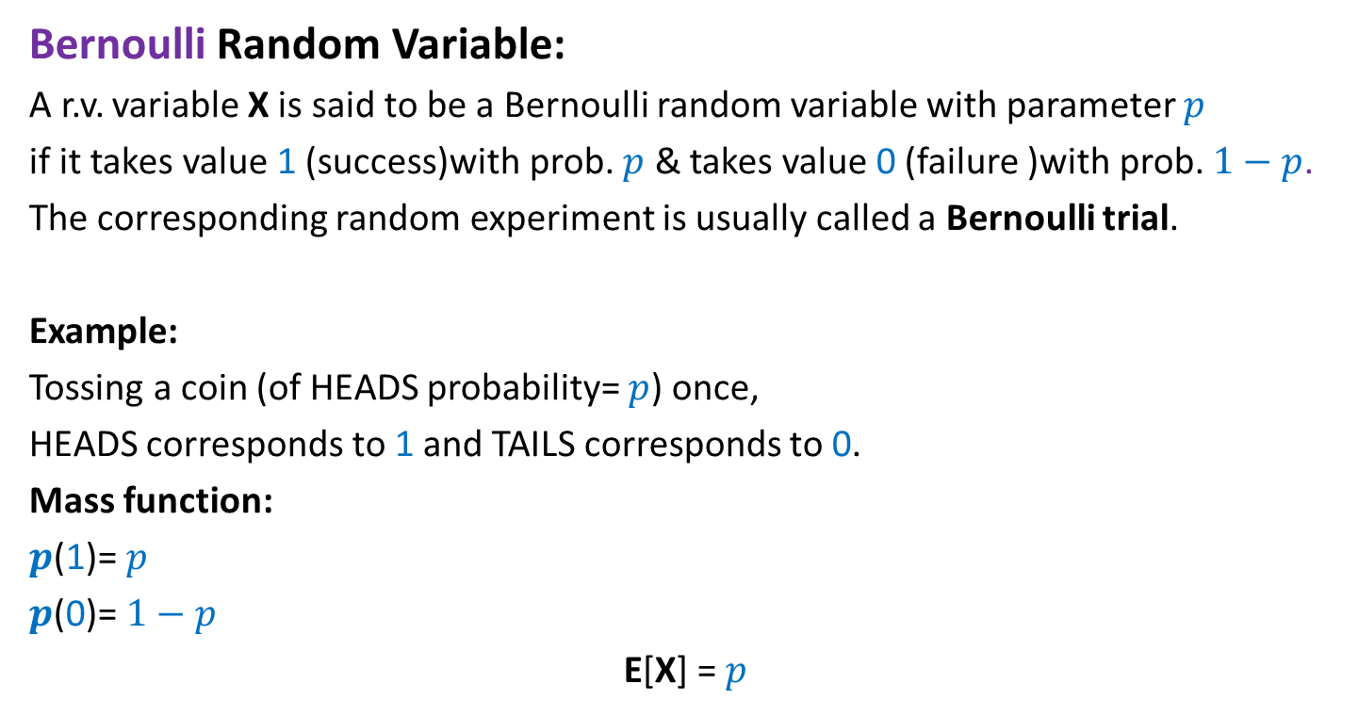
Bernoulli Random Variable
Bernoulli Random Variable:
A r.v. variable X is said to be a Bernoulli random variable with parameter $p$
if it takes value 1 (success)with prob. $p$ & takes value 0 (failure )with prob. $1−p$.
The corresponding random experiment is usually called a Bernoulli trial.
Example:
Tossing a coin (of HEADS probability= $p$) once,
HEADS corresponds to 1 and TAILS corresponds to 0.
Mass function:
$p$(1)= $p$
$p$(0)= $1−p$
E[X] = $p$

Slide 8

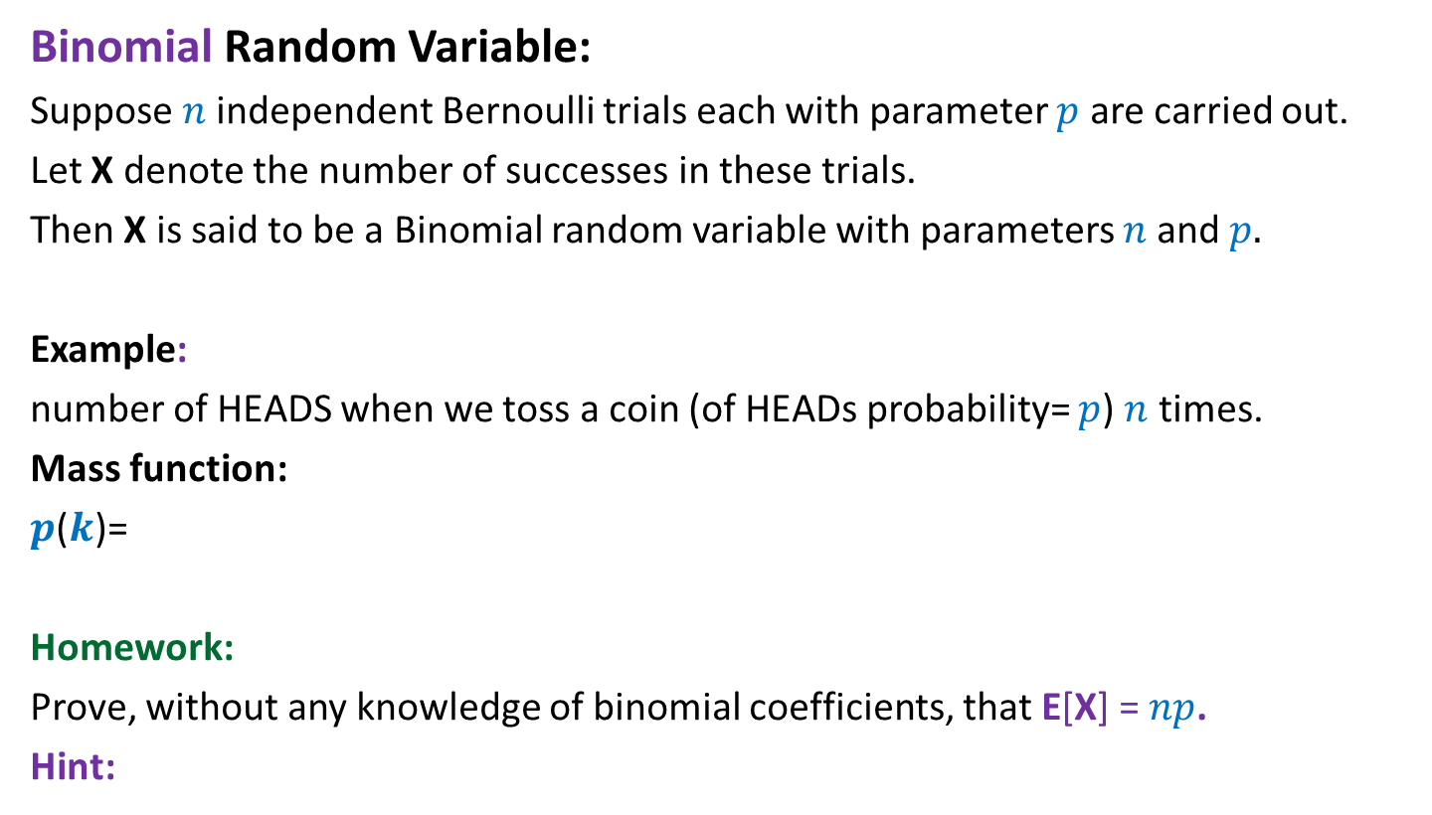

Binomial Random Variable
Binomial Random Variable:
Suppose $n$independent Bernoulli trials each with parameter $p$ are carried out.
Let X denote the number of successes in these trials.
Then X is said to be a Binomial random variable with parameters $n$and $p.$
Example:
number of HEADS when we toss a coin (of HEADs probability= $p$) $n$ times.
Mass function:
$p$($k$)=
Homework:
Prove, without any knowledge of binomial coefficients, that E[X] = $np$.
Hint:
$$\left({n \atop k}\right)p^{k}{\left(1−p\right)}^{k}$$
X = $X_{1}+…{+X}_{n}$
,where $X_{i}$ is a Bernoulli random variable for the $i$th Bernoulli trial.

Slide 9

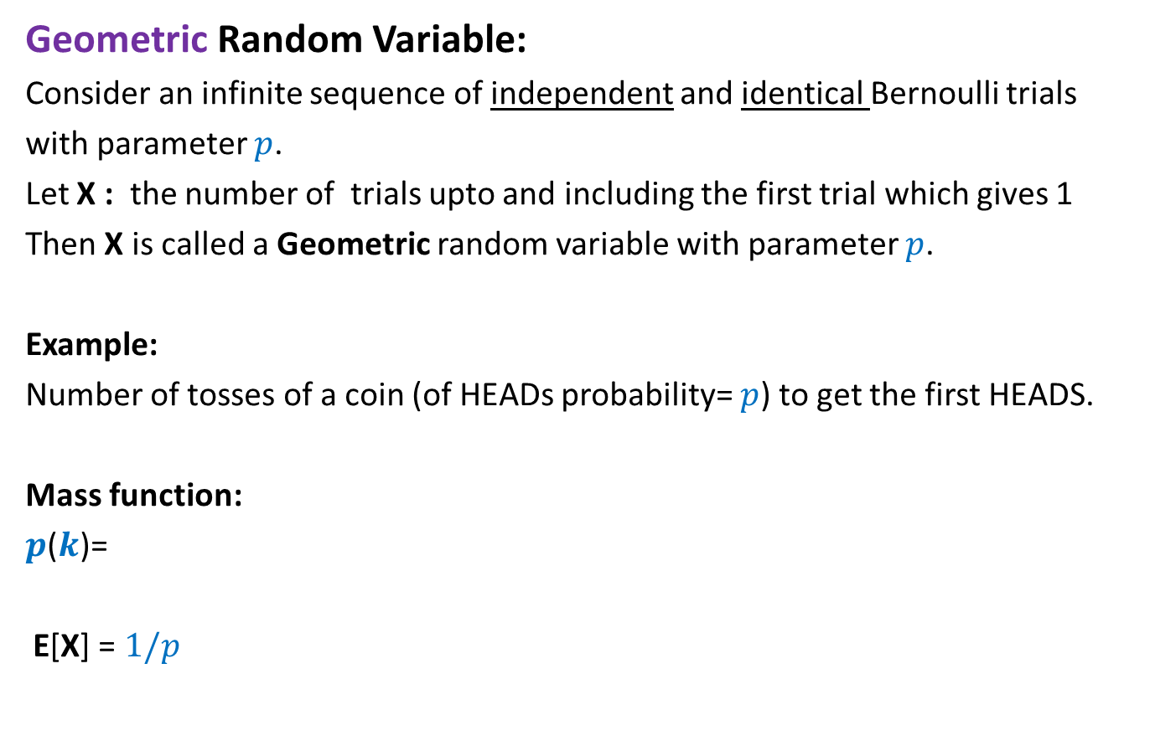
Geometric Random Variable
Geometric Random Variable:
Consider an infinite sequence of independent and identical Bernoulli trials
with parameter $p$.
Let X : the number of trials upto and including the first trial which gives 1
Then X is called a Geometric random variable with parameter $p$.
Example:
Number of tosses of a coin (of HEADs probability= $p$) to get the first HEADS.
Mass function:
$p$($k$)=
E[X] = $1/p$
$${\left(1−p\right)}^{k−1}p$$

Slide 10
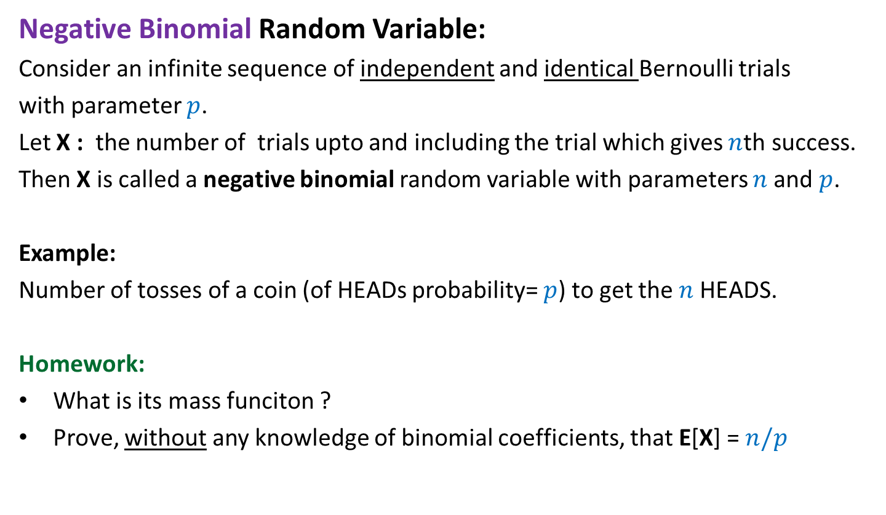
Negative Binomial Random Variable
Negative Binomial Random Variable:
Consider an infinite sequence of independent and identical Bernoulli trials
with parameter $p$.
Let X : the number of trials upto and including the trial which gives $n$th success.
Then X is called a negative binomial random variable with parameters $n$and $p$.
Example:
Number of tosses of a coin (of HEADs probability= $p$) to get the $n$HEADS.
Homework:
What is its mass funciton ?
Prove, without any knowledge of binomial coefficients, that E[X] = $n/p$

Slide 11

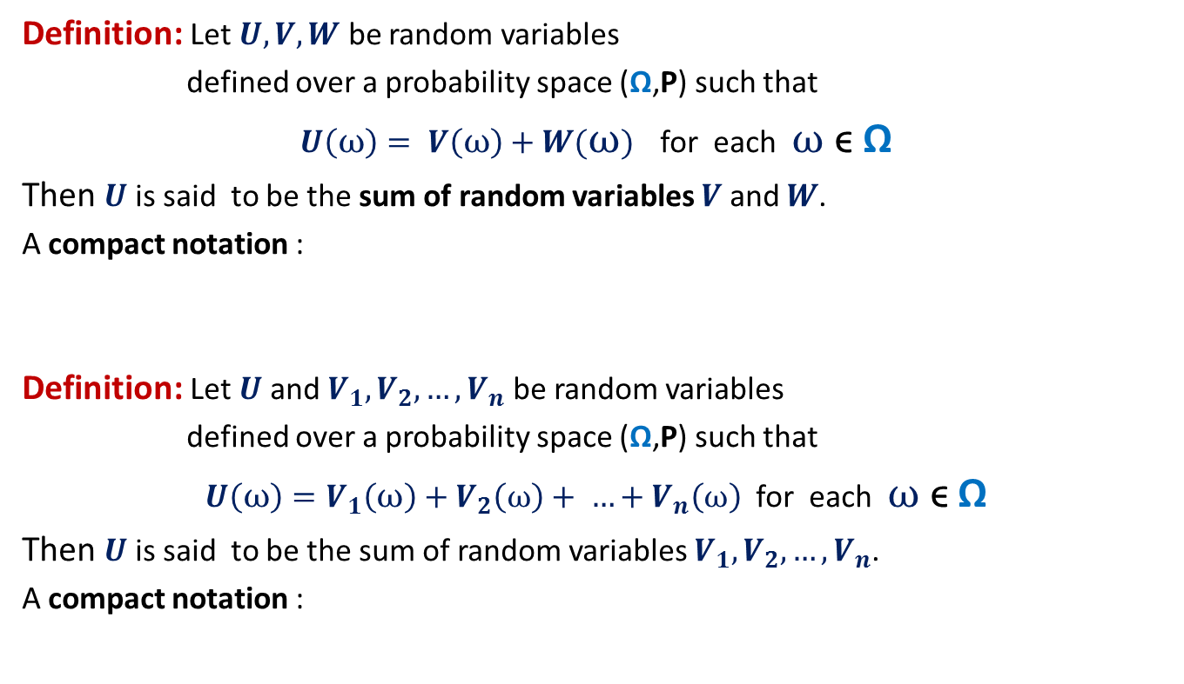

Sum of Random Variables
Definition: Let $U,V,W$ be random variables
defined over a probability space (Ω,P) such that
$U\left(ω\right)= V\left(ω\right)+W(ω)$ for each $ω$ ϵ Ω
Then $U$ is said to be the sum of random variables $V$ and $W$.
A compact notation :
Definition: Let $U$and $V_{1},V_{2},…,V_{n}$ be random variables
defined over a probability space (Ω,P) such that
$U\left(ω\right)=V_{1}\left(ω\right)+V_{2}\left(ω\right)+ …+V_{n}\left(ω\right)$ for each $ω$ ϵ Ω
Then $U$ is said to be the sum of random variables $V_{1},V_{2},…,V_{n}$.
A compact notation :
$$U=V+W$$
$$U=V_{1}+V_{2}+…+V_{n}$$

Slide 12
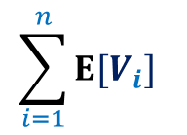

Linearity of Expectation
Let $U$and $V_{1},V_{2},…,V_{n}$ be random variables
defined over a probability space (Ω,P) such that
$$U=V_{1}+V_{2}+…+V_{n}$$
Then
$E\left[U\right]=$
$$\sum_{i=1}^{n}{E[V_{i}]}$$

Slide 13
Homework from last class

Slide 14


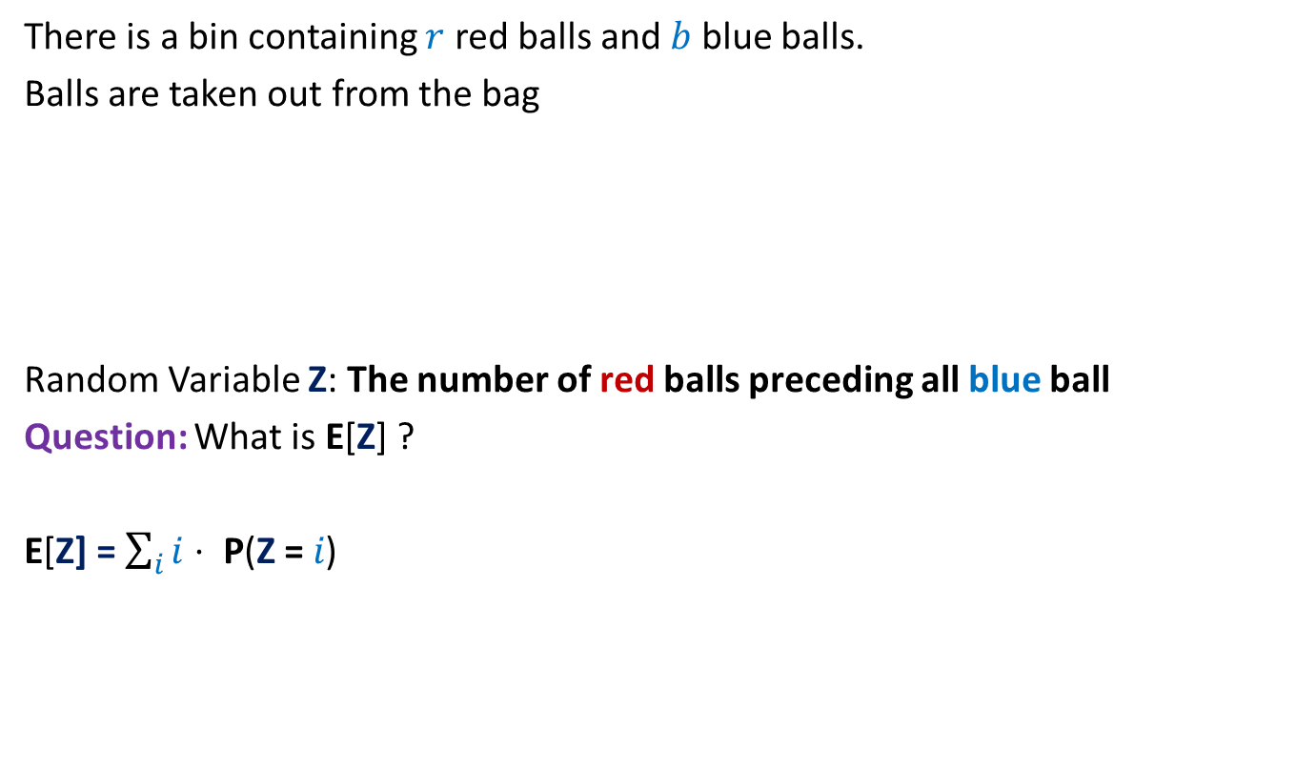

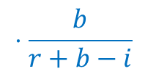
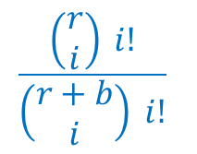
Problem 3: Balls Out of Bag
There is a bin containing $r$ red balls and $b$ blue balls.
Balls are taken out from the bag
Random Variable Z: The number of red balls preceding all blue ball
Question: What is E[Z] ?
E[Z] = $\sum_{i}{i⋅ \text{P}\text{(}\text{Z}\text{ =} i\text{)}}$
uniformly randomly
and without replacement.
…
$i$ red balls
$1$ blue ball
It appears too complicated
to compute E[Z].
$$\frac{\left(\begin{matrix}r \\ i\end{matrix}\right) i!}{\left(\begin{matrix}r+b \\ i\end{matrix}\right) i!}$$
$$⋅\frac{b}{r+b−i}$$
$\text{P}\text{(}\text{Z}\text{ =} i$) =

Slide 15
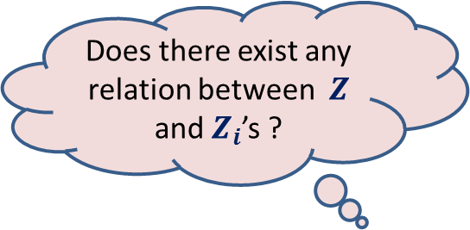












Problem 3: Balls Out of Bag
$$i$$
$$3$$
$Z_{i}$ = $\left\{\begin{matrix}1 \\ 0 \end{matrix}\right.$
Question: What is E[$Z_{i}$] ?
Answer :
E[$Z_{i}$] =
= $\text{P}\text{(}ith red ball precedes all blue balls\text{)}$
=
Using Linearity of Expectation
$E$[$Z$] $=\sum_{1≤i≤r}{E[Z_{i}]}$
$=$
$$1$$
$$2$$
$$Z=\sum_{i=1 to r}{Z_{i}}$$
$if ith red ball precedes all blue balls$
$$otherwise$$
Does there exist any relation between $Z$ and $Z_{i}$’s ?
$1$ $∙$ $P\text{(}ith red ball precedes all blue balls\text{) }$
+ $0$ $∙$ $P\text{(}ith red ball precedes all blue balls)$
$$\frac{1}{b+1}$$
Homework
Based on Partition theorem
$$\frac{r}{b+1}$$
It is so easy and compact

Slide 16
Practice sheet 2
8 problems on Linearity of Expectation

Slide 17










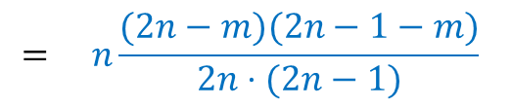

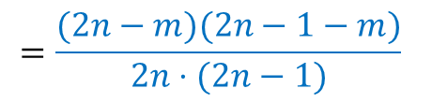

Problem 5
Of the $2n$ people in a given collection of $n$ couples, exactly $m$ die.
Assume that the $m$ have been picked uniformly at random.
Find the expected number of surviving couples.
$Z$ : The number of surviving couples.
E[$Z_{i}$] = $\text{P}\text{(}ith couple survives\text{)}$
Using Linearity of Expectation
$E$[$Z$] $=\sum_{1≤i≤n}{E[Z_{i}]}$
…
…
…
…
$$1$$
$$2$$
$$3$$
$$i$$
$$n$$
$$Z=\sum_{i=1 to n}{Z_{i}}$$
$if ith couple survives$
Does there exist any relation between $Z$ and $Z_{i}$’s ?
$Z_{i}$ = $\left\{\begin{matrix}1 \\ 0 \end{matrix}\right.$
$$otherwise$$
$$= \frac{\left(\begin{matrix}2n−2 \\ m\end{matrix}\right) }{\left(\begin{matrix}2n \\ m\end{matrix}\right)}$$
$$=\frac{(2n−m)(2n−1−m)}{2n⋅(2n−1)}$$
$$= n\frac{(2n−m)(2n−1−m)}{2n⋅(2n−1)}$$

Slide 18

Conditional Expectation
$$E[X|ε]$$

Slide 19

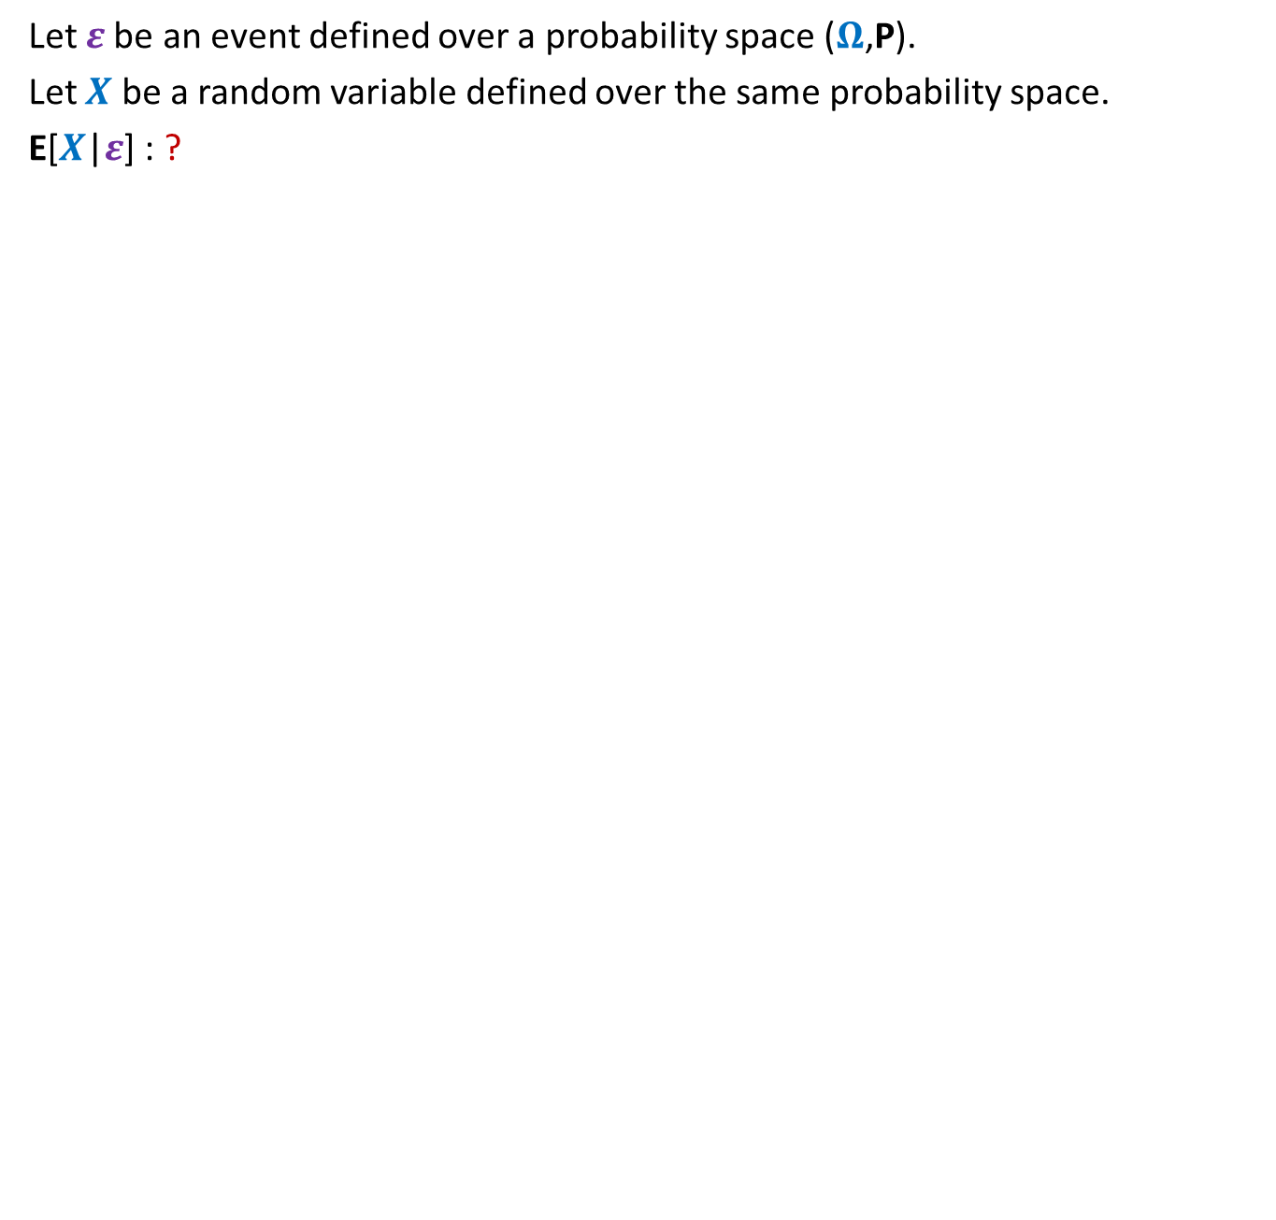



Conditional Expectation
Let $ε$be an event defined over a probability space ($Ω$,P).
Let $X$ be a random variable defined over the same probability space.
E[$X$|$ε$] : ?
Expected value of $X$
given that event $ε$ has happened.
$$ε$$
Ω
With calm mind, try to understand what it means.
It is the expected value of $X$, where expectation is taken over all elementary events of $ε$.

Slide 20

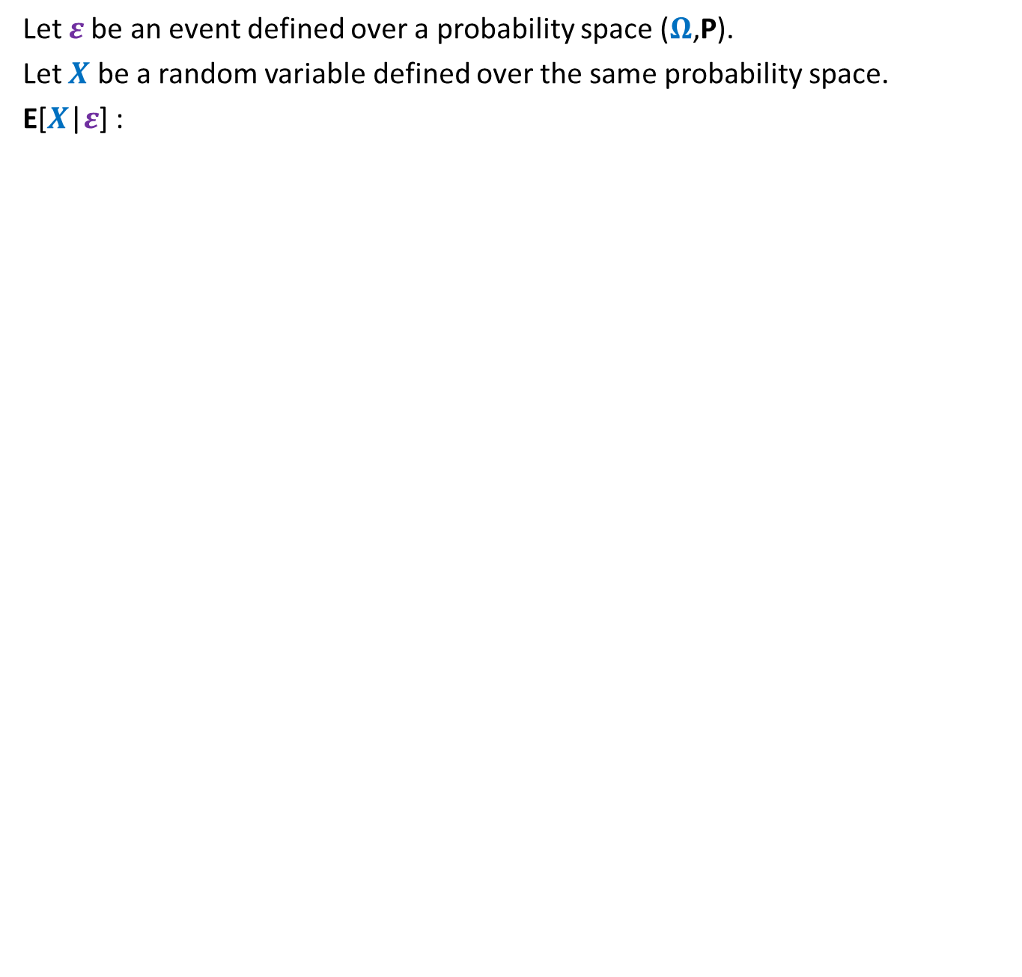
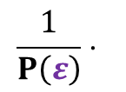


Conditional Expectation
Let $ε$be an event defined over a probability space ($Ω$,P).
Let $X$ be a random variable defined over the same probability space.
E[$X$|$ε$] :
Expected value of $X$
given that event $ε$ has happened.
$$ε$$
What is still missing in this equation ?
E[$X$|$ε$] =
$$\frac{1}{P\left(ε\right)}⋅$$
$$\sum_{ω∈ε }{X\left(ω\right)⋅P(ω)}$$
It is the expected value of $X$, where expectation is taken over all elementary events of $ε$.

Slide 21

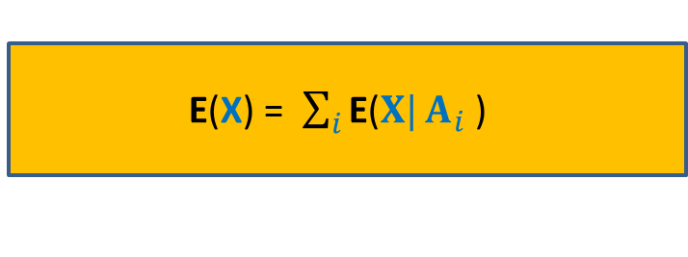







Partition of sample space
A set of events $A_{1}$,…, $A_{n}$ defined over a probability space ($Ω$,P)
is said to induce a partition of $Ω$ if
$\bigcup_{i=1}^{n}{A_{i}}$ = $Ω$
$A_{i}\bigcap{A_{j}}$ =∅ for all$i≠j$
For a random variable X, how can we express E(X) in terms of a given partition ?
$$A_{6}$$
$$A_{5}$$
$$A_{4}$$
$$A_{1}$$
$$A_{3}$$
Ω
$$A_{2}$$
E(X) = $\sum_{i}{\text{E}\text{(}X|}A_{i}$ )
$$⋅\text{P}\text{(}A_{i}\text{)}$$

Slide 22













Miner’s Problem
3 hours
$X$ : The number of hours to escape from the mine.
$E[X]$ =
=
=
➔ $E[X]$ =
Door 1
Door 2
Door 3
7 hours
5 hours
$E\left[X\right|ε_{1}]⋅P[ε_{1}]$
$+ E\left[X\right|ε_{2}]⋅P[ε_{2}]$
$+ E\left[X\right|ε_{3}]⋅P[ε_{3}]$
$\frac{1}{3}\left( E\left[X\right|ε_{1}\right] + E\left[X\right|ε_{2}]$ + $E\left[X\right|ε_{3}] )$
$5+E[X]$
$3$
$7+E[X]$
$\frac{1}{3}( +$ $)$
$15$
$$2 E[X]$$
$15$

Slide 23
Homework from today’s class
Solve Problem 2 of Practice sheet 2 using conditional expectation.
Solve all the problems of Practice sheet 2.

